Slide 1
Lecture 4

Slide 2
Forward Market
A forward contract is an agreement between a corporation and a financial institution:
  To exchange a specified amount of currency
  At a specified exchange rate called the forward rate
  On a specified date in the future

Slide 3
Forward Market
How MNCs Use Forward Contracts
Hedge their imports by locking in the rate at which they can obtain the currency
Bank Quotations on Forward Rates
Bid/Ask Spread is wider for less liquid currencies
May negotiate an offsetting trade if an MNC enters into a forward sale and a forward purchase with the same bank
Non-deliverable forward contracts (NDF) can be used for emerging market currencies where no currency delivery takes place at settlement, instead one party makes a payment to the other party

Slide 4
Forward Market
Premium or Discount on the Forward Rate
F = S(1 + p)
where:
  F is the forward rate
  S is the spot rate
  p is the forward premium, or the percentage by which the forward rate exceeds the spot rate.
  Arbitrage: If the forward rate was the same as the spot rate, arbitrage would be possible

Slide 5
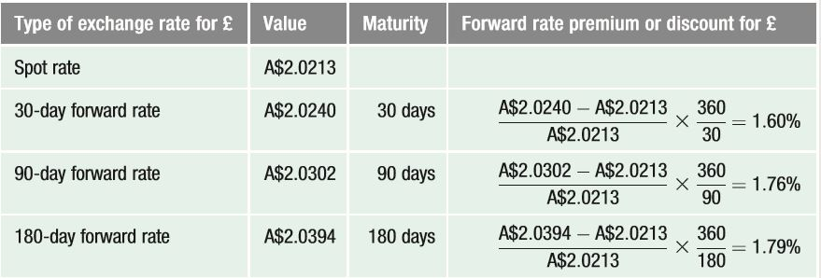
Computation of Forward Rate Premiums or Discounts

Slide 6
Forward Market
Movements in the Forward Rate over Time
  The forward premium is influenced by the interest rate differential between the two countries and can change over time
Offsetting a Forward Contract
  An MNC can offset a forward contract by negotiating with the original counterparty bank
Using Forward Contracts for Swap Transactions
  Involves a spot transaction along with a corresponding forward contract that will ultimately reverse the spot transaction
Non-deliverable forward contracts (NDF)
  Can be used for emerging market currencies where no currency delivery takes place at settlement; instead one party makes a payment to the other party

Slide 7
Currency Futures Market
Similar to forward contracts in terms of obligation to purchase or sell currency on a specific settlement date in the future
Contract Specifications: Differ from forward contracts because futures have standard contract specifications:
  Standardised number of units per contract
  Offer greater liquidity than forward contracts
  Typically based on US dollar, but may be offered on cross-rates
  Commonly traded on the Chicago Mercantile Exchange (CME)

Slide 8
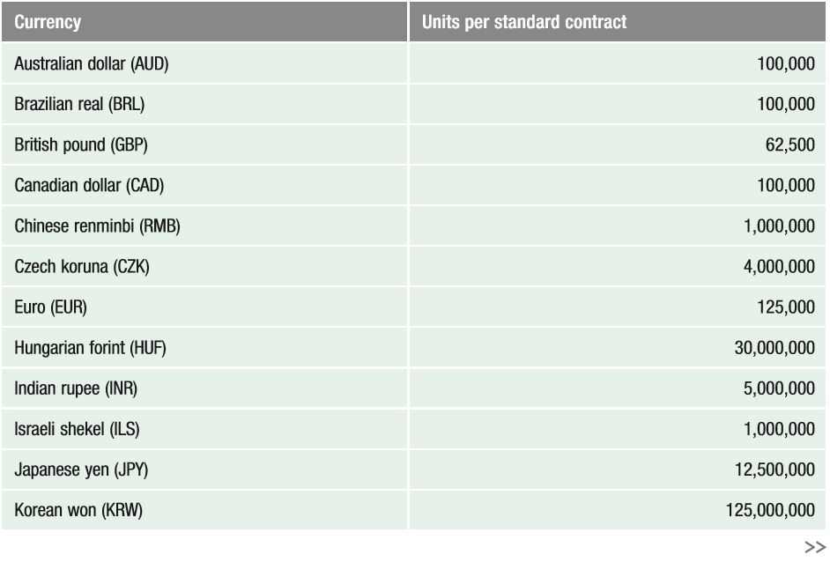
Currency Futures Contracts Traded on the Chicago Mercantile Exchange

Slide 9
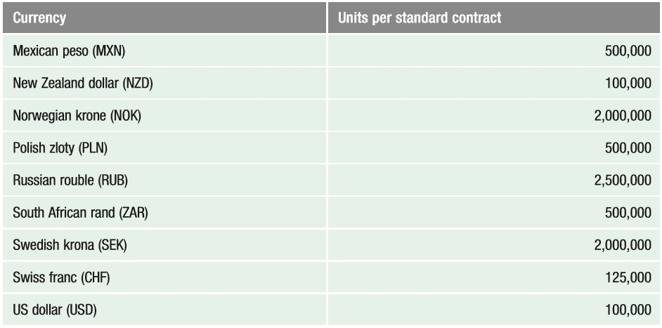
Currency Futures Contracts Traded on the Chicago Mercantile Exchange

Slide 10
Currency Futures Market
Trading Currency Futures
Firms or individuals can execute orders for currency futures contracts by calling brokerage firms
Trading platforms for currency futures: Electronic trading platforms facilitate the trading of currency futures. These platforms serve as a broker, as they execute the trades desired
Currency futures contracts are similar to forward contracts in that they allow a customer to lock in the exchange rate at which a specific currency is purchased or sold for a specific date in the future

Slide 11
Currency Futures Market
Comparing Futures to Forward Contracts
Currency futures contracts are similar to forward contracts in that they allow a customer to lock in the exchange rate at which a specific currency is purchased or sold for a specific date in the future
Pricing Currency Futures: The price of currency futures will be similar to the forward rate
Credit Risk of Currency Futures Contracts
To minimise its risk, the CME imposes margin requirements to cover fluctuations in the value of a contract, meaning that the participants must make a deposit with their respective brokerage firms when they take a position

Slide 12
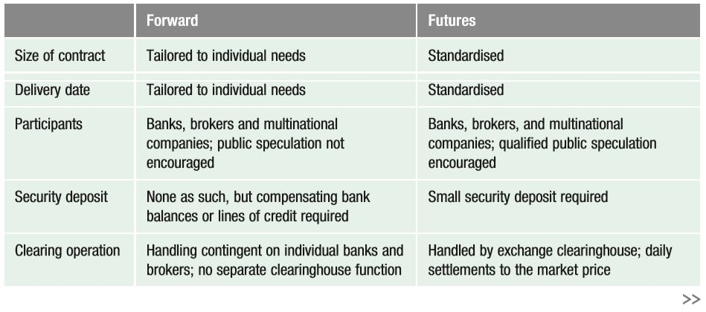
Comparison of the Forward and Futures Market

Slide 13
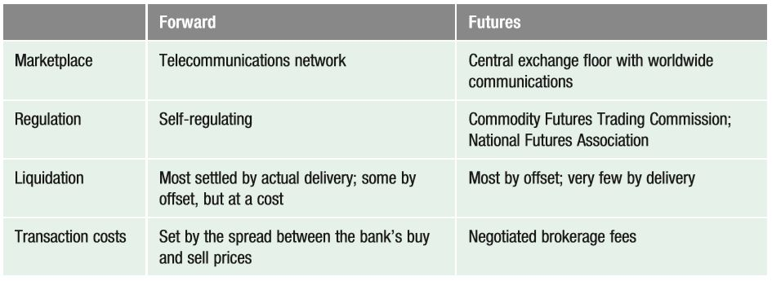
Comparison of the Forward and Futures Market

Slide 14
Currency Futures Market
How Firms Use Currency Futures
Purchasing Futures to Hedge Payables: The purchase of futures contracts locks in the price at which a firm can purchase a currency.
Selling Futures to Hedge Receivables: The sale of futures contracts locks in the price at which a firm can sell a currency.
Closing Out a Futures Position:
  Sellers (buyers) of currency futures can close out their positions by buying (selling) identical futures contracts prior to settlement
  Most currency futures contracts are closed out before the settlement date.

Slide 15
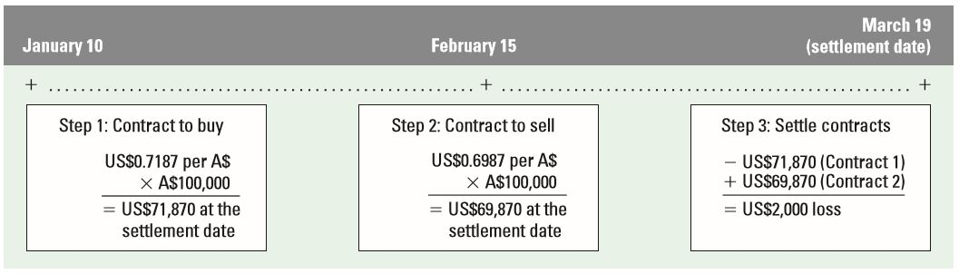
Closing Out a Futures Contract

Slide 16
Currency Futures Market
Speculation with Currency Futures
Currency futures contracts are sometimes purchased by speculators attempting to capitalise on their expectation of a currency’s future movement
Currency futures are often sold by speculators who expect that the spot rate of a currency will be less than the rate at which they would be obligated to sell it

Slide 17
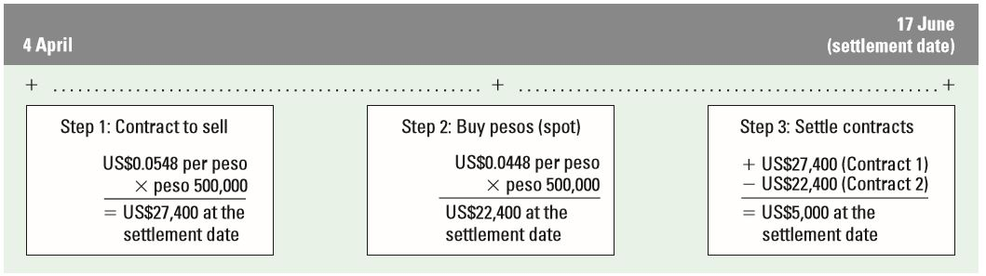
Source of Gains from Buying Currency Futures

Slide 18
Currency Futures Market
Speculation with Currency Futures
Efficiency of the currency futures market
  If the currency futures market is efficient, the futures price should reflect all available information
  Thus, the continual use of a particular strategy to take positions in currency futures contracts should not lead to abnormal profits
  Research has found that the currency futures market may be inefficient
  However, the patterns are not necessarily observable until after they occur, which means that it may be difficult to consistently generate abnormal profits from speculating in currency futures

Slide 19
Currency Options Markets
Currency options provide the right to purchase or sell currencies at specified prices
Options Exchanges
  1982 - exchanges in Amsterdam, Montreal and Philadelphia first allowed trading in standardised foreign currency options.
  2007 – CME and CBOT merged to form CME group
  Exchanges are regulated by the SEC in the US
Over-the-counter market
  Where currency options are offered by commercial banks and brokerage firms
  Unlike the currency options traded on an exchange, the over-the-counter market offers currency options that are tailored to the specific needs of the firm

Slide 20

Currency Call Options
Factors Affecting Currency Call Option Premiums
The premium on a call option (C) is affected by three factors:
  Spot price relative to the strike price (S – X): The higher the spot rate relative to the strike price, the higher the option price will be
  Length of time before expiration (T): The longer the time to expiration, the higher the option price will be
  Potential variability of currency (σ): The greater the variability of the currency, the higher the probability that the spot rate can rise above the strike price

Slide 21
Currency Call Options
How Firms Use Currency Call Options
  Using call options to hedge payables
  Using call options to hedge project bidding to lock in the dollar cost of potential expenses
  Using call options to hedge target bidding of a possible acquisition

Slide 22
Currency Call Options
Speculating with Currency Call Options
Individuals may speculate in the currency options based on their expectations of the future movements in a particular currency
Speculators who expect that a foreign currency will appreciate can purchase call options on that security
The net profit to a speculator is based on a comparison of the selling price of the currency versus the exercise price paid for the currency and the premium paid for the call option

Slide 23
Currency Call Options
Speculating with Currency Call Options
Break-even point from speculation
  Break even if the revenue from selling the currency equals the payments made for the currency plus the option premium
Speculation by MNCs
  Some institutions may have a division that uses currency options to speculate on future exchange rate movements
  Most MNCs use currency derivatives for hedging and not speculation

Slide 24

Currency Put Options
Factors Affecting Put Option Premiums
Put option premiums are affected by three factors:
  Spot rate relative to the strike price (S–X): The lower the spot rate relative to the strike price, the higher the probability that the option will be exercised
  Length of time until expiration (T): The longer the time to expiration, the greater the put option premium
  Variability of the currency (σ): The greater the variability, the greater the probability that the option may be exercised

Slide 25
Currency Put Options
Hedging with Currency Put Options
Corporations with open positions in foreign currencies can use currency put options in some cases to cover these positions
Some put options are deep out of the money, meaning that the prevailing exchange rate is high above the exercise price. These options are cheaper (have a lower premium), as they are unlikely to be exercised because their exercise price is too low
Other put options have an exercise price that is currently above the prevailing exchange rate and are therefore more likely to be exercised. Consequently, these options are more expensive

Slide 26
Currency Put Options
Speculating with Currency Put Options
Individuals may speculate with currency put options based on their expectations of the future movements in a particular currency
Speculators can attempt to profit from selling currency put options. The seller of such options is obligated to purchase the specified currency at the strike price from the owner who exercises the put option
The net profit to a speculator is based on the exercise price at which the currency can be sold versus the purchase price of the currency and the premium paid for the put option

Slide 27
Currency Put Options
Speculating with Currency Put Options
Speculating with combined put and call options
  Straddle – uses both a put option and a call option at the same exercise price
  Good for when speculators expect strong movement in one direction or the other
Efficiency of the currency options market
  Research has found that, when transaction costs are controlled for, the currency options market is efficient
  It is difficult to predict which strategy will generate abnormal profits in future periods

Slide 28
Currency Put Options
Conditional Currency Options
A currency option can be structured with a conditional premium, meaning that the premium paid for the option is conditioned on the actual movement in the currency’s value over the period of concern
Firms also use various combinations of currency options

Slide 29
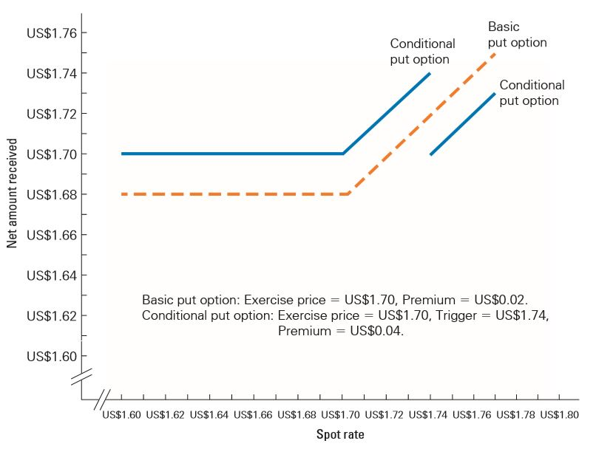
Comparison of Conditional and Basic Currency Options

Slide 30
Currency Put Options
Asia-Pacific Example
Background:
Infosys Limited is a major Indian technology service company has received a new order from a US company for US$200 million for exporting services but incurs approximately 80 per cent of its expenses in Indian rupees (INR) and the rest in USD.
The payments were to occur semi-annually over the next five years.

Slide 31
Currency Put Options
Asia-Pacific Example
Analysis:
Infosys Limited hedges USD-denominated payment exposure through buying a put option with a strike price of INR68
Each instalment payment is US$16 million [US$200 million/10 (payments) x 0.80 (80 per cent expenses in INR)]
Put options premium is INR2.4 million (INR0.15/US$ x US$1000 x 16,000).
Put options Net payoff is INR1085.6 million [(US$16 million x INR68) - INR2.4 million]
The put options hedging strategy would be profitable if the company expected that the US dollar remains at INR68 or below at the maturity. If the company expected the INR to weaken against the US dollar (i.e., US dollar is appreciated, it is better off being unhedged).

